Slide 1
Twitter Mining Project
Ying Li

Slide 2
Four steps
Step 1
Step 2
Step 3
Step 4
Choose my brand
Four analysis to use
What can we learn form analysis
conclusion

Slide 3
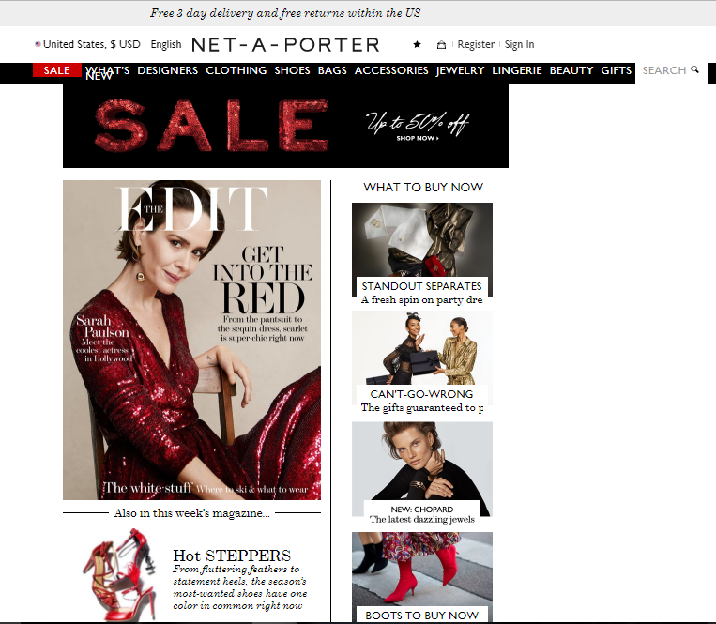
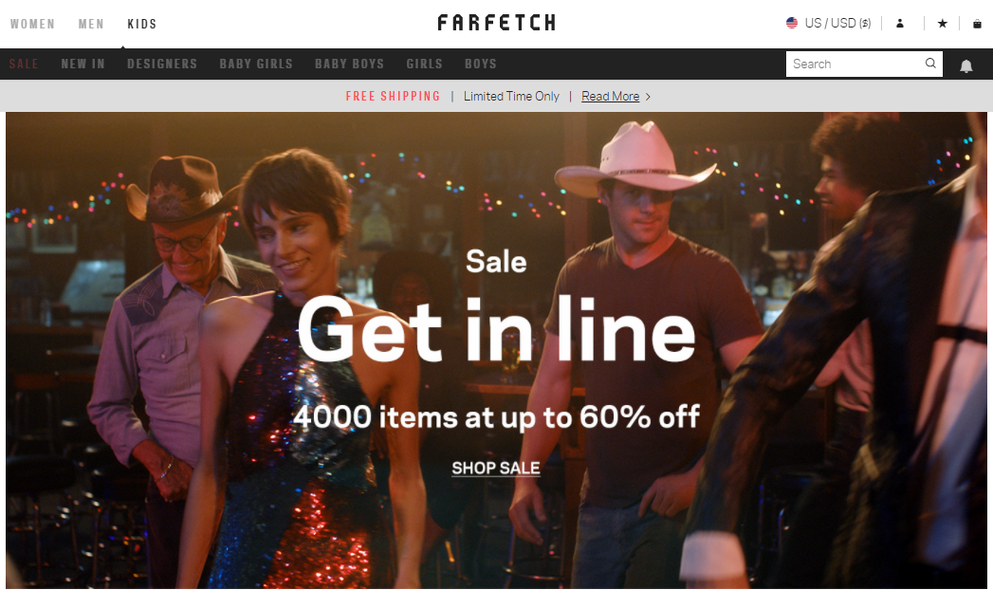
My Brand?
Net A Porter Farfetch

Slide 4
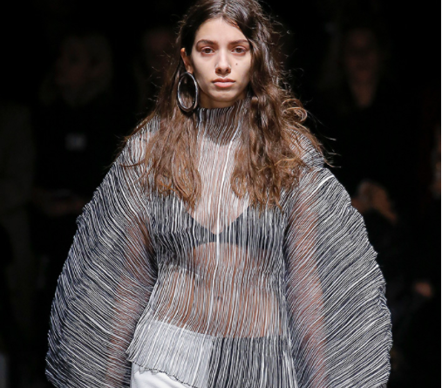
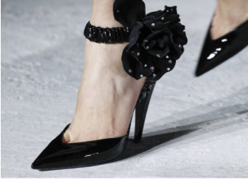
Why Net a porter & farfetch?
Love fashion
Love buying

Slide 5



What objective?
Net A Porter
Farfetch

Slide 6
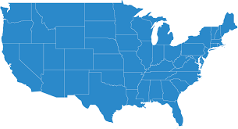
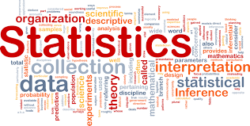
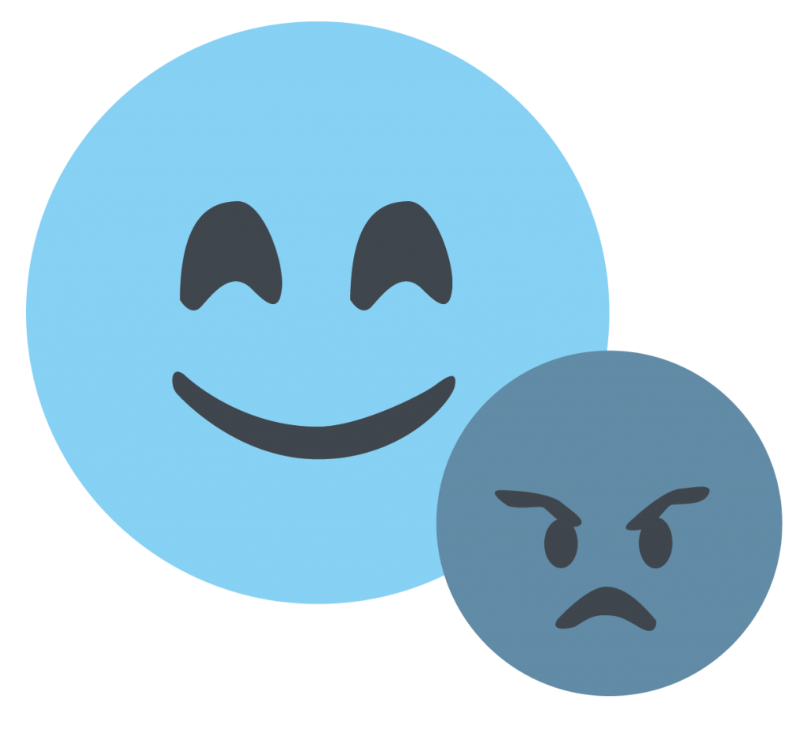
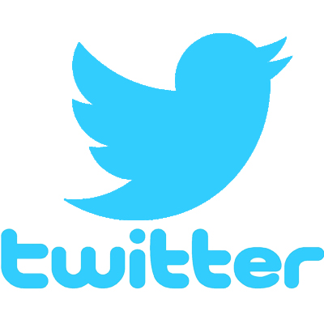
What analysis to use
Maps
Word Cloud
Sentiment analysis
Timeline

Slide 7
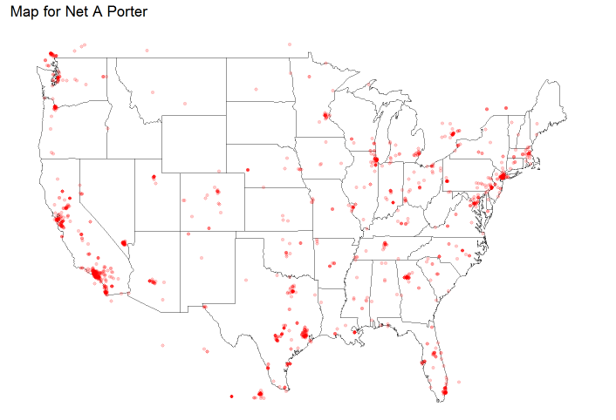
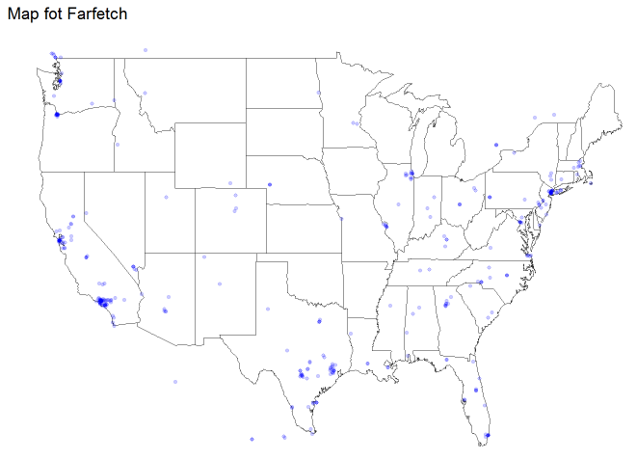
maps

Slide 8
What do maps say?
The people talking about net a porter are most from Los Angeles, San Francisco and aNew York.
It makes sense because from my perspective of view, those three places are the place of fashion, that is to say, most of the fashion bloggers are from those three places.
The situation is the same for Farfetch, however comparing two maps, we can clearly see that the map for Net A Porter has more points than the map for Farfetch.

Slide 9
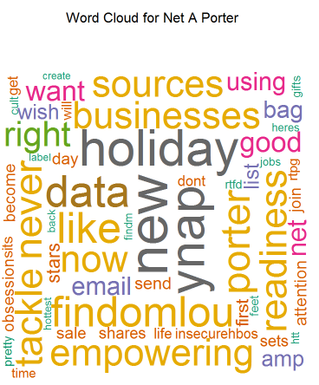
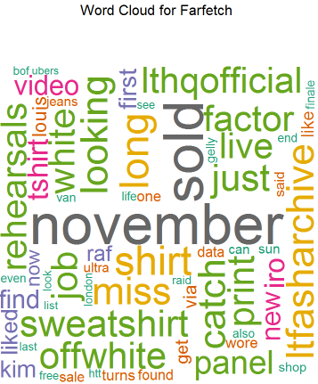
Word cloud

Slide 10
What does word cloud say?
The words with the highest frequency are all positive words, same situation is applied for the word cloud of Farfetch. However, we can only see the words frequency of these two online fashion retailers, it is hard for me to compare people’s attitude towards these two shops.
To really get hold of the people’s feelings towards these two shops. Doing a sentiment analysis is necessary. Therefore for the next part of my analysis I did a sentiment analysis.

Slide 11
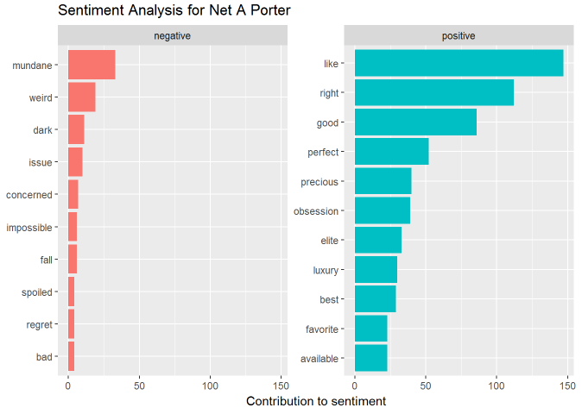
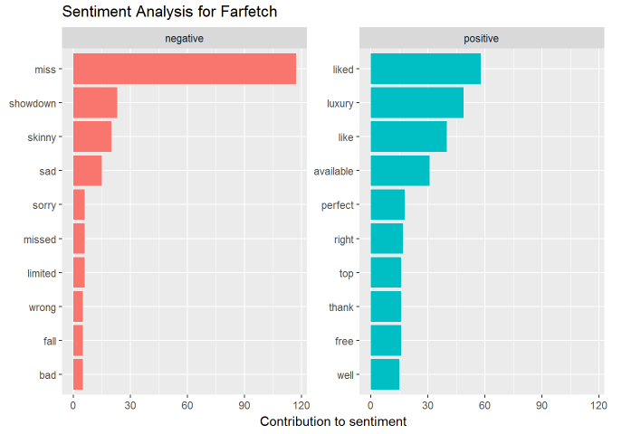
Sentiment analysis

Slide 12
What does sentiment analysis say?
For Net A Porter, we can see that most of the feeling are positive and there are only a little words that are negative.
For Farfetch, the situation is quite different, the number of positive words are relatively low. And there is an unexpected negative words with high frequency.
To compare those two plots, it is quite obvious that people have a better feeling towards Net A Porter than towards Farfetch.

Slide 13
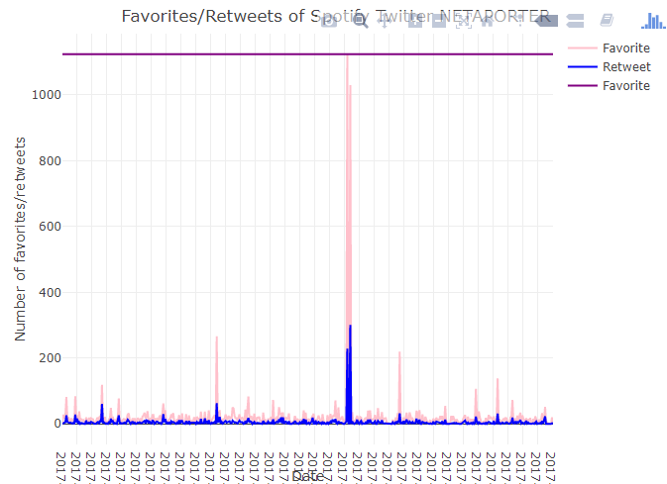
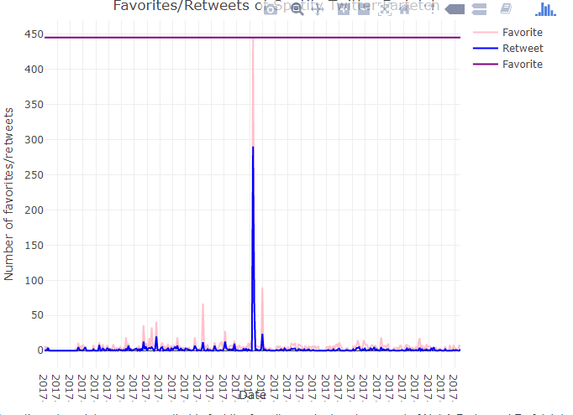
tIMELINE

Slide 14
WHAT DOES TIMELINE SAY?
In fact the favorites and retweets amount of Net A Porter and Farfetch twitter is pretty low, my guess is that twitter is not that popular these days while instagram is.
From these two plots, we can easily see that there is a high peak for both of the plots. I check the twitter and find out the post with the highest favorite amount, my guess is that this post has information that most people agree with.

Slide 15
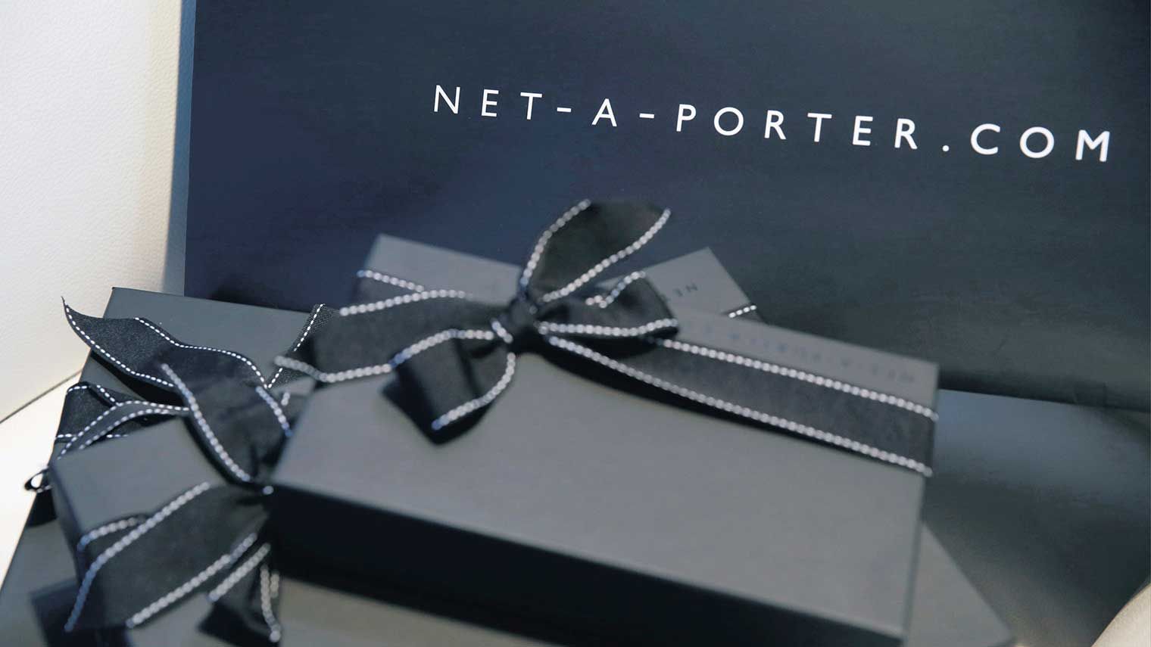
conclusion
Net
A
Porter
better?

Slide 16
QUESTIONS?
Code can be found here:
https://github.com/YingLi99/615-twitter-mining

